Slide 1
Operating System
By Siddhi. B

Slide 2
Unit- 1
Introduction to Operating System
Types of Operating System
Operating System Organization

Slide 3
What is Operating System ?
Basic Structure of OS
How does it work ?
Characteristics of OS.
Advantage and Disadvantage of OS

Slide 4
What is Operating Systems ?
An operating system is a program that manages the computer hardware. It also provides a basis for application programs and acts as an intermediary between the computer user and the computer hardware.
Operating systems for handheld computers are designed to provide an environment in which a user can easily interface with the computer to execute programs.

Slide 5
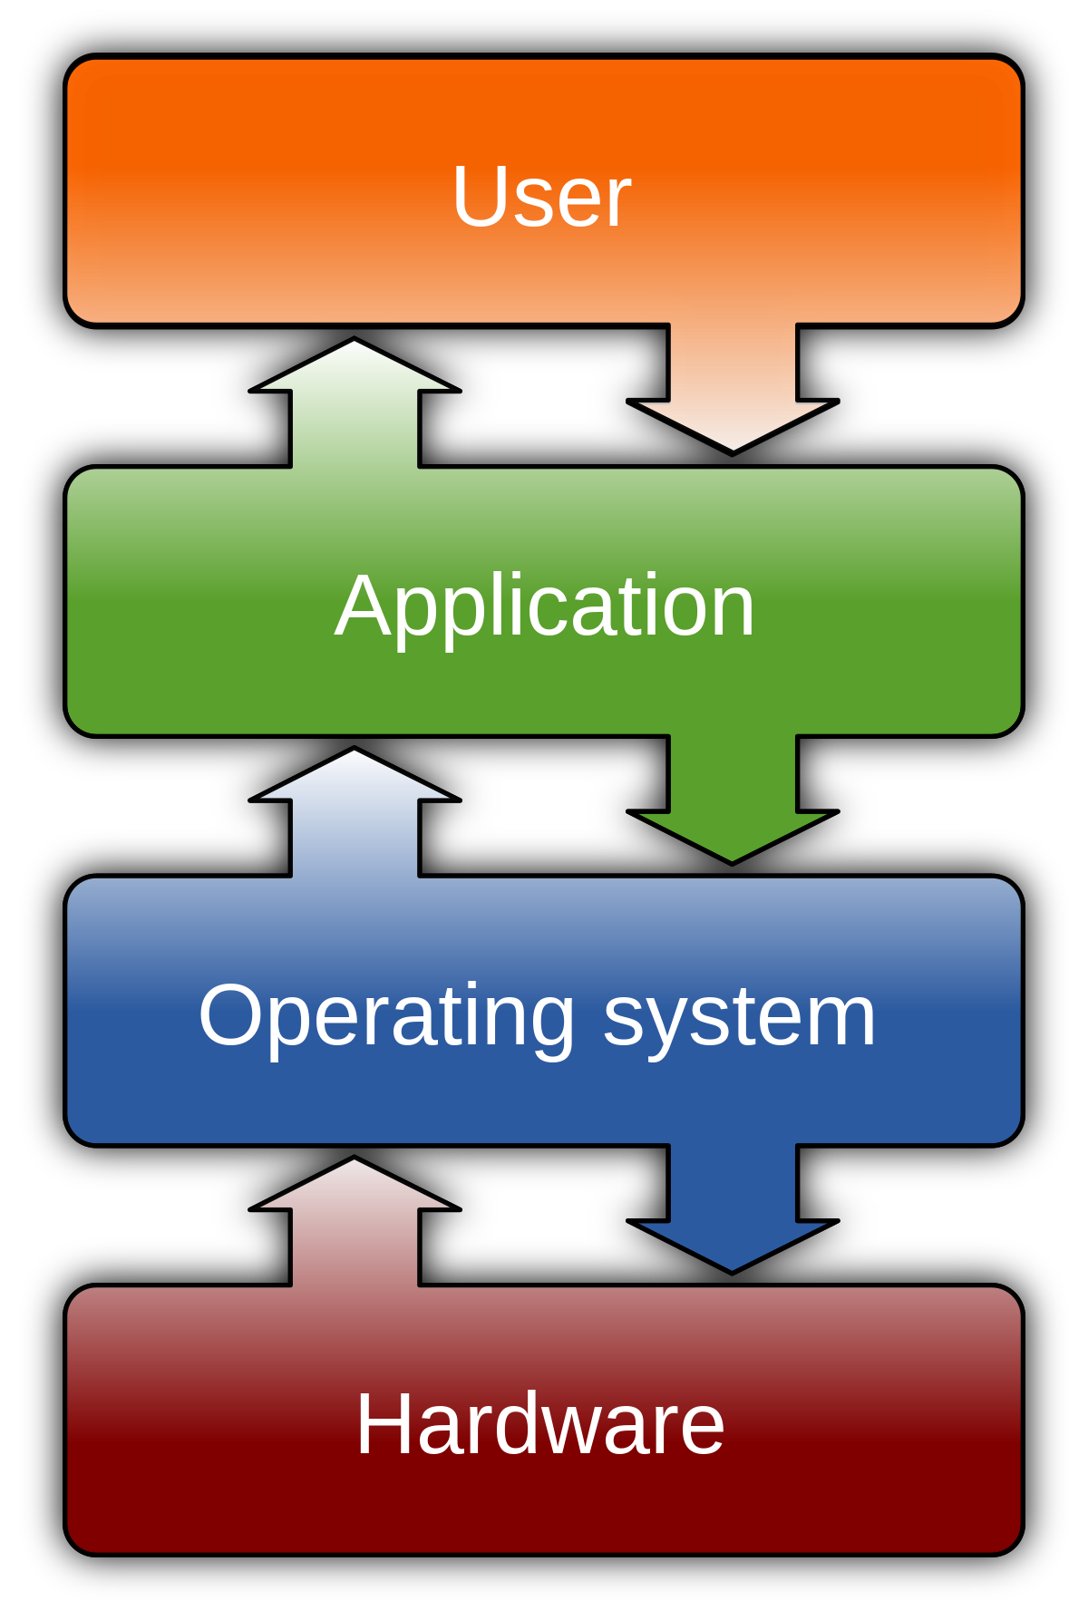
Basic Operating Structure /Working:

Slide 6
Characteristics of OS
Scheduling
Memory Management
Security
Interact with different software
Device management
File management

Slide 7
Advantages and disadvantages
Advantages
Disadvantages
OS provides a GUI interface for the users in the form of menu, icon and buttons.
OS also allows us to share the resources with other users.
It helps users to understand the functions of a computer.
It is user friendly and easy to use.
It can be easily updated.
If the OS get corrupted than it will affect entire system.
Only some of the task runs at a particular time.

Slide 8
Examples of OS:
The operating system (prominent examples being Microsoft Windows, macOS, Linux etc), allows the parts of a computer to work together by performing tasks like transferring data between memory and disks or rendering output onto a display device.

Slide 9
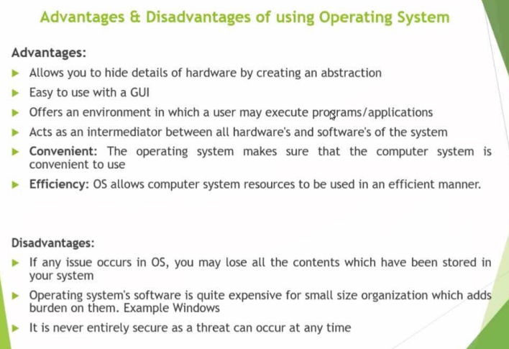

Slide 10
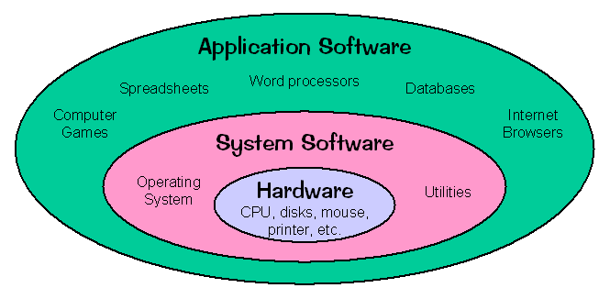
System software
System software is a type of computer program that is designed to run a computer's hardware and application programs.
The operating system is the best-known example of system software. The OS manages all the other programs in a computer.
Essentially, system software provides a platform for application software to be run on top of.

Slide 11
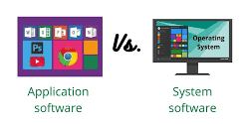
System Software V/s Application Software
System Software
Application Software
System s/w is used for operating computer hardware.
System s/w are installed on the computer when operating system is installed.
It provides platform for running application s/w.
System s/w can work or run independently.
In general, the user does not interact with system s/w because it works in background.
It start’s running automatically when computer is turned on and stop when computer is shut down.
Example : OS
Application s/w is used by user to perform specific task as per its requirement.
Application s/w are installed according to user’s requirements.
Application s/w can not run without the presence of system s/w.
While application s/w can’t run or work independently.
But, here user interact with application software.
It runs when the user request it as per is requirements.
Example : Microsoft Office, Photoshop, Browser etc.

Slide 12
Important features of system software
System Software is given inbuilt in the devices by the manufacturers. The features of system software are:
Fast in Speed
System Software is made to be as fast as possible to provide an effective platform for higher-level software.
Hard to Manipulate
System Software is hard to manipulate as they do not directly interact with users and are written in a more complex programming language.
Written in Low-Level Language
System Software is written in low-level language so the CPU and other hardware can understand it.
Close to the System
It is directly connected to the hardware and enables them to run.
Difficult to Design
Designing software is a complicated task as they are written in a lower-level language.

Slide 13
Types of System Software
Operating system
An operating system is system software that provides a platform between computer hardware, application software, and end-users. It is pre-installed on devices and allows them to be identified and then function. OS is the first thing to be loaded when a system is started.
Device Drivers
A Device Driver is system software that operates or controls a particular device attached to a computer. It is the device drivers who make it possible for all the external devices to perform their tasks. Most of the hardware comes with pre-installed drivers in it. However, if the device is new to the system, then the user may have to download the drivers.

Slide 14
BIOS
BIOS (Basic Input/Output System) gets the computer system started when we turn it on. BIOS also manages the flow of information between operating systems and the attached devices.
Programming Language Translator
These are the intermediate system software through which programmers convert the high-level language programming code to machine-level language code. Assembler, Interpreter, and Compiler are the popular language translators. They are usually designed by the computer manufacturer and are deliver inbuilt with the system.
Utilities
Utilities are the type of system software that is present between user and application software. These are the programs designed to configure, analyze, optimize and maintain tasks of the computer. Their task varies from disk fragmentation to data security.

Slide 15
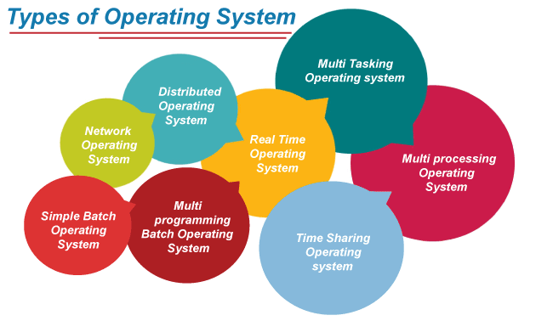
Types of Operating System
An operating system is a well-organized collection of programs that manages the computer hardware. It is a type of system software that is responsible for the smooth functioning of the computer system.

Slide 16
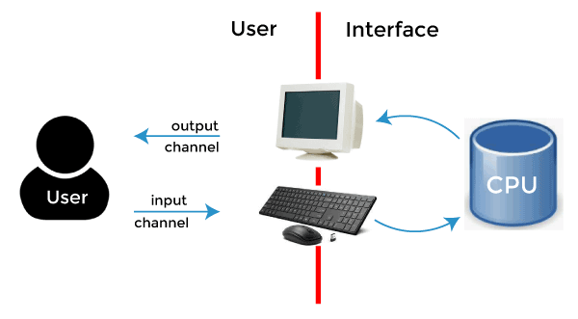
Single User Operating System
A single-user operating system is a type of operating system developed and intended for use on a computer or similar machine that will only have a single user at any given time.
This type of OS is typically used on devices like wireless phones and two-way messaging devices.
Key Points:
Allows a single user to access any particular computer at any one time.
Eg. The Laptop or PC that we use at our home (DOS, Windows, Linux).

Slide 17
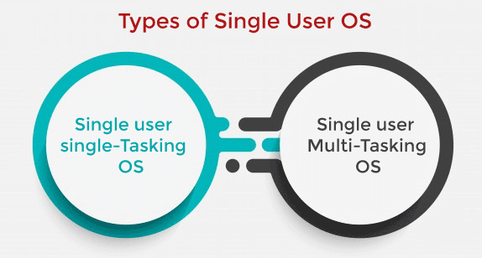
Only one user is permitted for performing a single task at a time.
Some functions such as printing a document and downloading images and videos are performed in one given frame.
Single user can perform multiple tasks simultaneously.
For example, you can write any text while surfing the internet, downloading images, watching movies, etc., on Windows, Linux, Mac O/S.

Slide 18
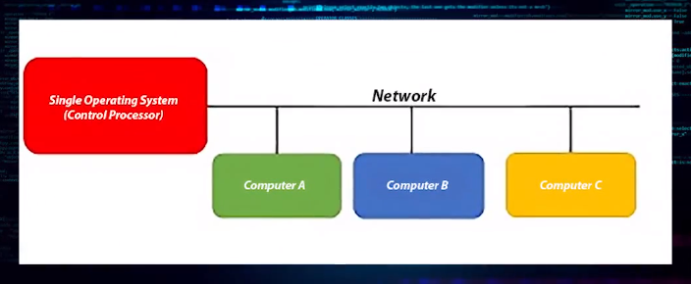
Multi-user Operating system
A computer system that allows multiple users that are on different computers to access a single system's OS resources simultaneously.
A multi-user operating system varies from a connected single-user operating system in that each user accesses the same operating system from different machines.

Slide 19
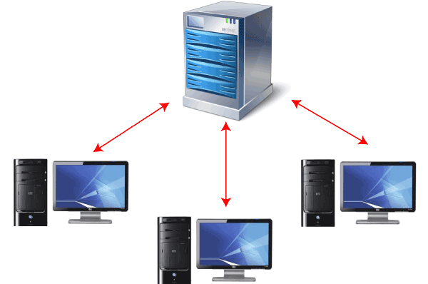
Example:
This multi-user operating system is now often used in large organizations, the government sector, educational institutions like large universities, and on servers' side such as Ubuntu Server or Windows Server. These servers allow several users to access the operating system, kernel, and hardware at the same time.

Slide 20
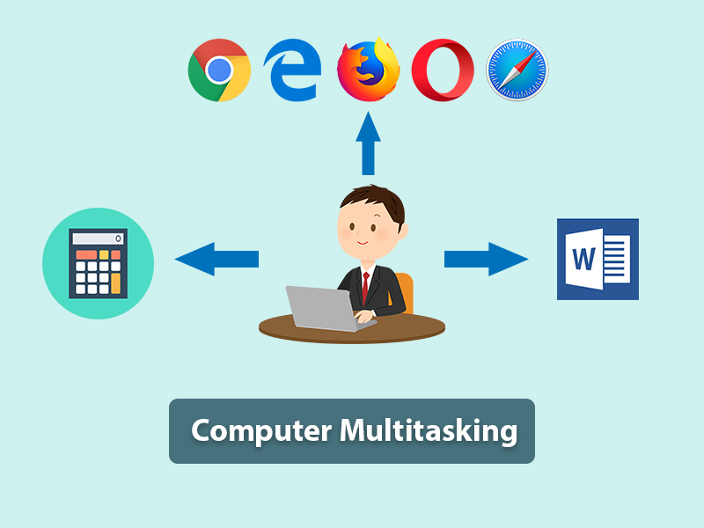
Multi-tasking Operating system
Multi Tasking Operating System refers to the ability of a computer to perform more than one task or program at a time.
Tasks, can execute (i.e., run) on a single computer seemingly simultaneously and without interfering with each other.

Slide 21
Revision of Batch Operating System.
Multi-Programming Operating System.
Multi- Tasking/ Time Sharing Operating System.
Diff. Multi-Progm and Multi- task OS.

Slide 22
1. Batch operating System
Some computer processes are very lengthy and time-consuming.
To speed the same process, a job with a similar type of needs is batched together and run as a group.
Batch OS groups jobs that perform similar type of functions. These groups are called as batch and are executed at the same time.
The user of a batch operating system never directly interacts with the computer.
In this type of OS, every user prepares his or her job on an offline device like a punch card and submit it to the computer operator.
The system put all the jobs in a queue on the basis of first come first serve and then executes the jobs one by one. The users collect their respective output when all the jobs get executed.

Slide 23
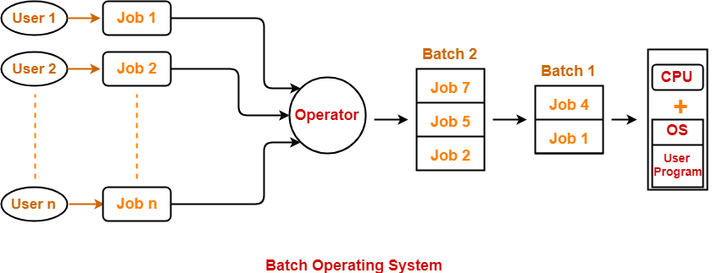
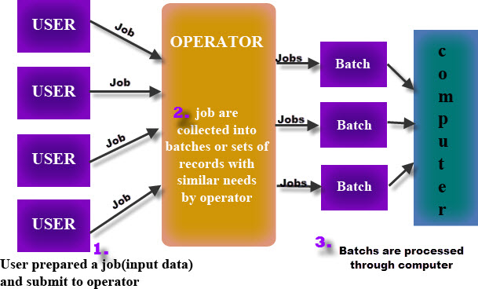

Slide 24
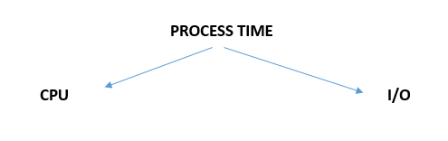
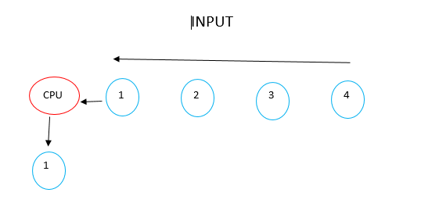

Slide 25
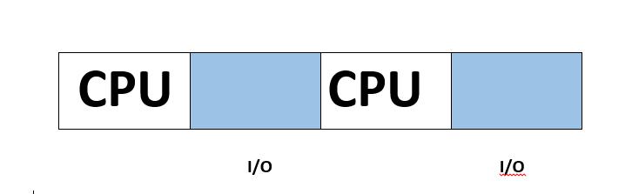
The problems with Batch Systems are as follows −
Lack of interaction between the user and the job.
CPU is often idle, because the speed of the mechanical I/O devices is slower than the CPU.
Batch processing suffers from starvation. :
If there are five jobs J1, J2, J3, J4, J4 and J5 present in the batch. If the execution time of J1 is very high, then other four jobs will never be going to get executed or they will have to wait for a very high time. Hence the other processes get starved.

Slide 26
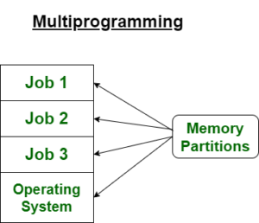
2. Multi-programming operating system
Multiprogramming is an extension to the batch processing where the CPU is kept always busy.
It is non- preemptive.
In multiprogramming OS, for the time a process does I/O, the CPU can start the execution of other process.

Slide 27
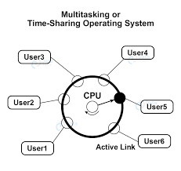
3.multi-tasking/ Timesharing Operating system
Multitasking is multiprogramming with time sharing.
It is preemptive.
In multitasking OS, each process is executed for a fixed time period.
After that fixed time, CPU is switched to other process.
This fixed time period is called time quantum. It is also called Time –sharing OS.

Slide 28
Multi- Programming OS
Multi-Tasking/ Time Sharing OS
Both of these concepts are for single CPU.
Concept of Context Switching is used.
Multi-programming increases CPU utilization by organising jobs .
The idea is to reduce the CPU idle time for as long as possible.
Both of these concepts are for single CPU.
Concept of Context Switching and Time Sharing is used.
In multi-tasking also increases CPU utilization, it also increases responsiveness.
The idea is to further extend the CPU Utilization concept by increasing responsiveness Time Sharing.

Slide 29
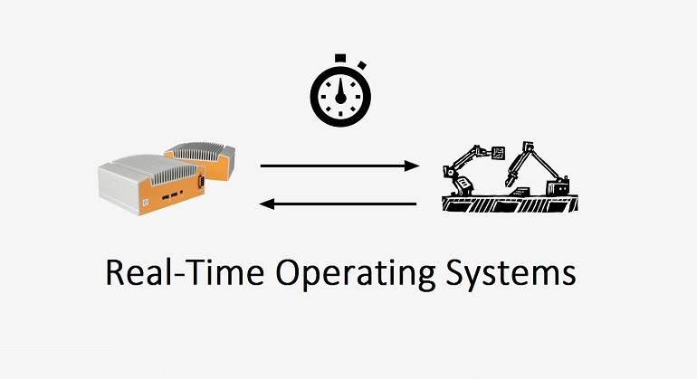
4. Real time operating system (RTOS)
In Real Time systems, each job carries a certain deadline within which the Job is supposed to be completed, otherwise the huge loss will be there or even if the result is produced then it will be completely useless.
Real Time OS is used where we require a quick response.
Example: Missile System.
Here, OS puts maximum efforts so that it can give quick response.
Other examples : Medical Imaging System, Air- traffic control system,
Home appliance control system.

Slide 30
Real Time Operating System is of two types:
1. Hard Real Time Operating System-
Stick very hardly to deadline.
Highest priority task first.
2. Soft Real Time Operating System-
Small delay can be accepted.
Mainly used in multimedia.

Slide 31
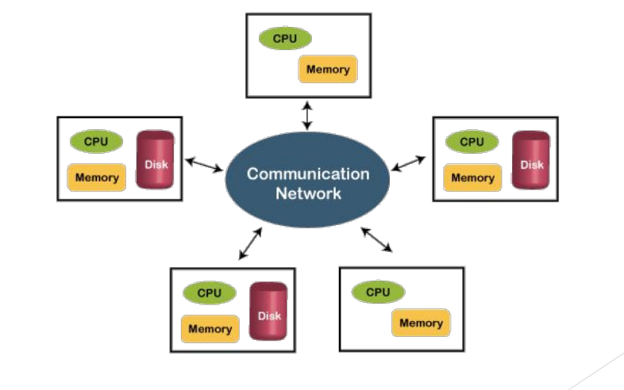
5. Distributed operating system
A distributed system is a collection of independent computers which are connected through network.
Distributed Operating System use multiple CPU to execute multiple processes.
The processors communicate with one another through various communication lines
These processors are referred as sites, nodes, computers.

Slide 32
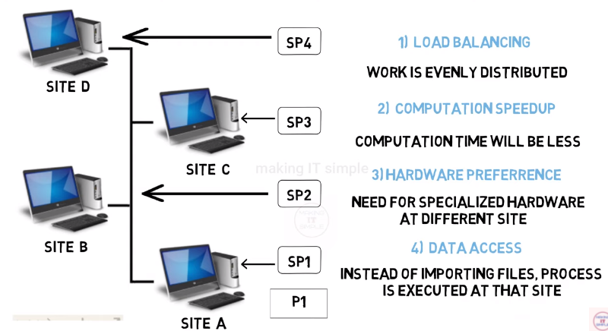

Slide 33
Advantages of distributed systems are as follows −
► With resource sharing facility, a user at one site may be able to use the resources available at another.
► Speedup the exchange of data with one another via electronic mail.
► If one site fails in a distributed system, the remaining sites can potentially continue operating.
► Better service to the customers.
► Reduction of the load on the host computer
Disadvantages of Distributed Operating System:
•Failure of the main network will stop the entire communication.

Slide 34
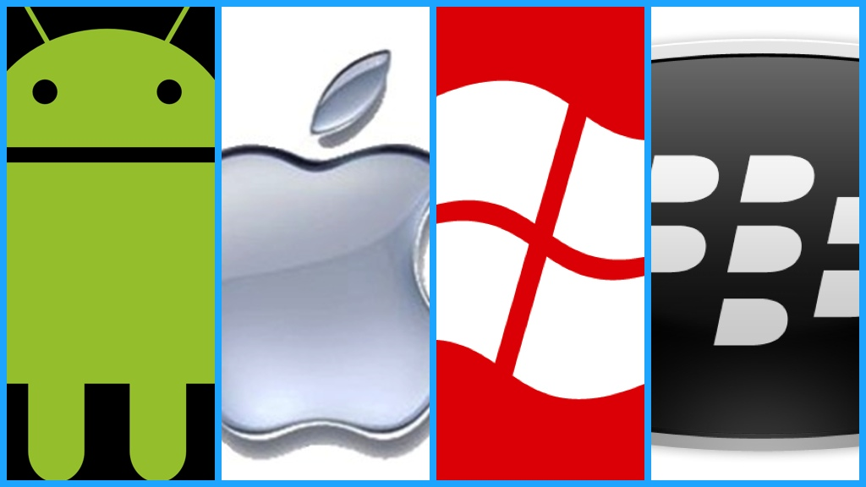
6. Mobile Operating System
A mobile operating system is an operating system that helps to run other application software on mobile devices.
► Much like the Linux or Windows operating system controls your desktop or laptop computer, a mobile operating system is the software platform on top of which other programs can run on mobile devices.
► Some most famous mobile operating systems are Android and iOS, but others include BlackBerry, Web, and watchOS.

Slide 35
Resource Abstraction
An abstraction is software that hides lower-level details and provides a set of higher-level functions.
Resource abstraction is used to hide the details of hardware by creating abstraction.

Slide 36
Operating System Organization

Slide 37
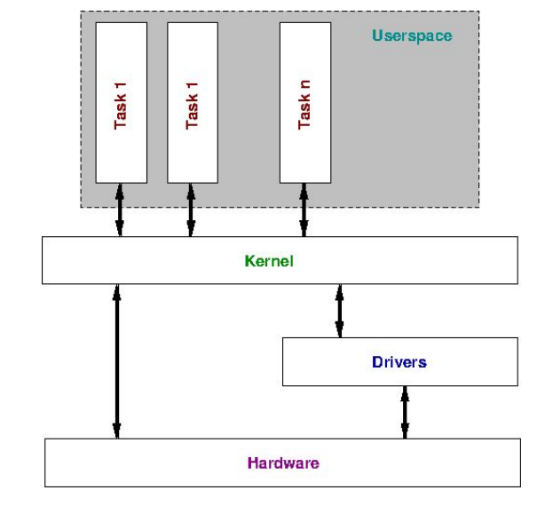
Operating System Organisation
There are two modes of operation in the operating system to make sure it works correctly. These are:
user mode and kernel mode.
In User, mode, the CPU executes the processes that are given by the user in the User Space.
There are certain instructions that need to be executed by Kernel only. So, the CPU executes these instructions in the Kernel Mode only. Eg. Memory Management.

Slide 38
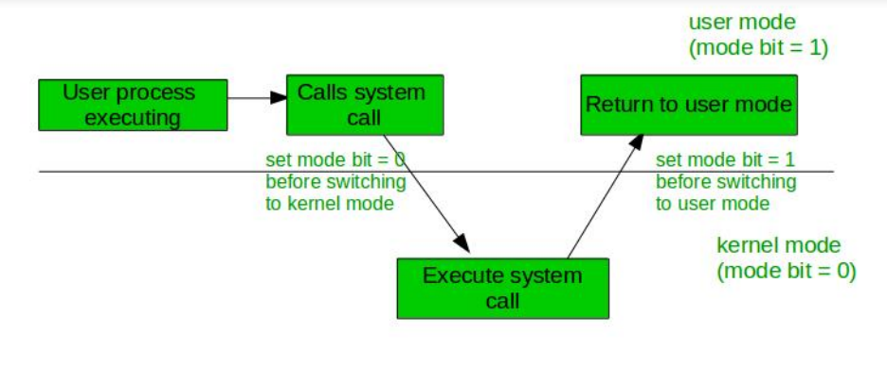
In the above image, the user process executes in the user mode until it gets a system
call. Then a system trap is generated, and the mode bit is set to zero. The system call
gets executed in kernel mode. After the execution is completed, again a system trap is generated, and the mode bit is set to 1. The system control returns to kernel mode and the process execution continues.

Slide 39
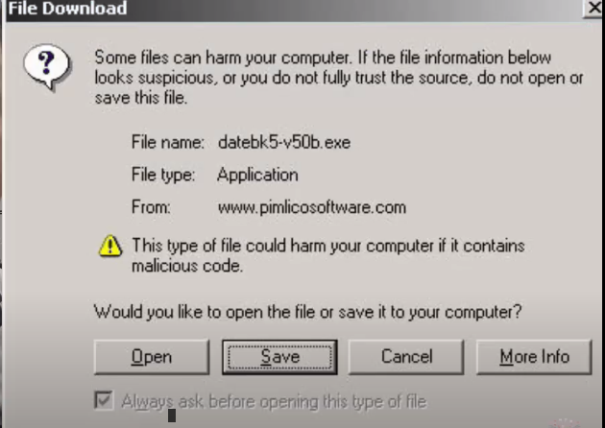
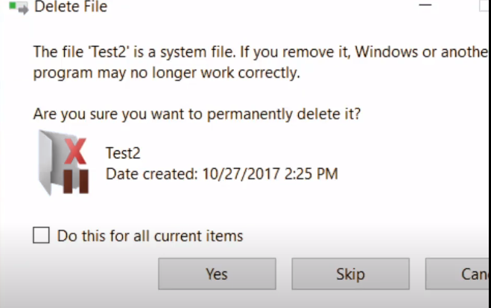
Example 3
Example 4
Here, we see this instruction comes from kernel mode.

Slide 40
User Mode
Kernel Mode
The system is in user mode when the operating system is running a user application. E.g. TextEditor.
The transition from user mode to kernel mode occurs when the application requests the help of operating system.
The mode bit is set to 1 in the user mode. It is changed from 1 to 0 when switching from user mode to kernel mode.
The system starts in kernel mode when it boots and after the operating system is loaded, it executes applications in user mode.
There are some privileged instructions that can only be executed in kernel mode.
The mode bit is set to 0 in the kernel mode. It is changed from 0 to 1 when switching from kernel mode to user mode.

Slide 41
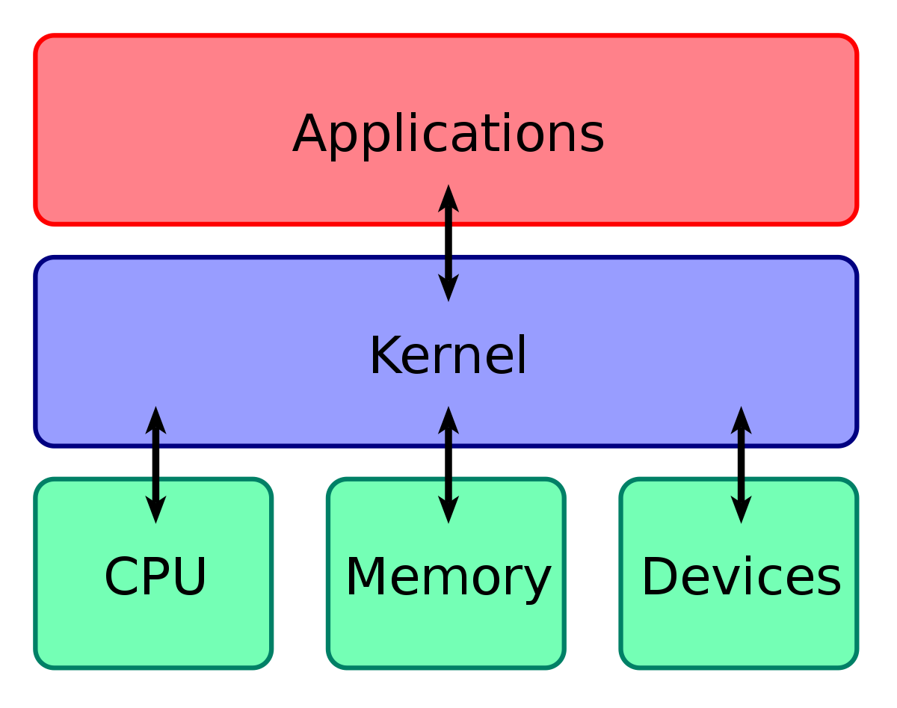
Kernel
A kernel is an important part of an OS that manages system resources.
► It also acts as a bridge between the software and hardware of the computer.
► It is one of the first program which is loaded on start-up after the boot loader.
► The Kernel is also responsible for offering secure access to the machine's hardware for
various programs.
► The Kernel is responsible for low-level tasks such as disk management, memory
management, task management, etc.
► It also decides when and how long a certain application uses specific hardware.
► When a process makes a request to the Kernel, then it is called System Call.

Slide 42
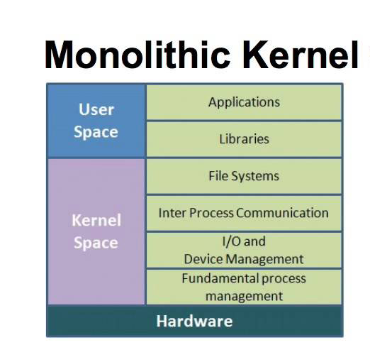
Types of Kernel
1. Monolithic Kernel:
Monolithic Kernels are those Kernels where the user services and the kernel services are implemented in the same memory space i.e. different memory for user services and kernel services are not used in this case.
By doing so, the size of the Kernel is increased and this, in turn, increases the size of the Operating System.
As there is no separate User Space and Kernel Space, so the execution of the process will be faster in Monolithic Kernels.

Slide 43
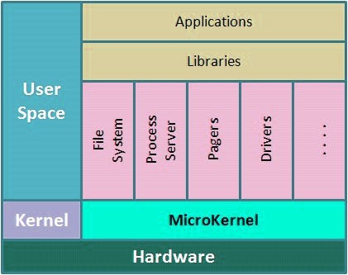
2. Micro Kernel
A Microkernel is different from Monolithic kernel because in a Microkernel, the user services and kernel services are implemented into different spaces i.e. we use User Space and Kernel Space in case of Microkernels.
As we are using User Space and Kernel Space separately, so it reduces the size of the Kernel and this, in turn, reduces the size of Operating System.
As we are using different spaces for user services and kernel service, so the communication between application and services is done with the help of message passing and this, in turn, reduces the speed of execution.

Slide 44
Basic os functions
Device Management
File Management
Process Management
Security
Job accounting
Networking
Error detecting aids
Communication Management
Memory Management

Slide 45
Basic implementation consideration
Three basic implementation mechanisms are used in every OS design.
Processor modes
Kernels
Method of requesting system device

Slide 46
1. Processor mode
2 types of modes in processor
► Supervisor mode: processor executes every instruction in hardware.
► User mode: executes only a subset of instructions.
► Supervisor mode also known as supervisor, privileged, protected mode.
► The mode bit is set by the user mode trap instruction, also called supervisor call instruction.

Slide 47
2. Kernels
The critical part of the system software that executes in supervisor mode.
► All application program execute in user mode.
► Operated as trusted software, means implement protection mechanisms that could not be changed actions of untrusted software executing in user mode.

Slide 48
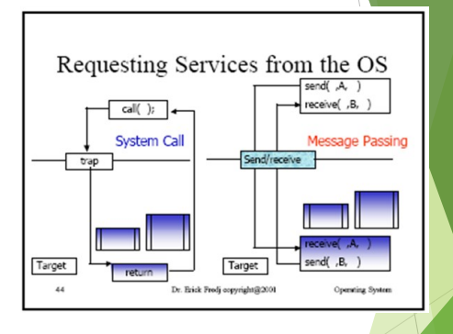
3.Method of requesting system device
Two techniques by which a program executing in user mode can request the kernels services:
► System call- a program that requests service from kernel and provide the interface between process and OS.
► Message passing- uses a common mailbox to pass messages between processes

Slide 49
